Slide 1
University Management System

Slide 2
INTRODUCTION
The university needs a centralized system to manage:
- Students
- Professors
- Courses & Enrollment
- Departments
- Student Clubs
- Books & Borrowing
- Projects & Collaboration

Slide 3
BUSINESS REQUIREMENTS OVERVIEW
  Unique IDs for all main entities (Student, Professor, Course, Dept., Book, Club, Project)
  Students may enroll in multiple courses
  Professors belong to one department & may supervise or advise students
  Students may join clubs (optional)
  Students can borrow books from the library
  Projects require collaboration among students, professors, and departments
  Student has multi-valued attributes (phone numbers)

Slide 4
MAIN ENTITIES
  Student
  Professor
  Department
  Course
  Book & Library
  Club
  Project
  Academic Advisor

Slide 5
STUDENT ENTITY
  Student Attributes:
  Student ID (PK)
  Student Name
  Email
  Date of Birth → used to calculate Age
  Phone Number (multi-valued)
  University ID Card (Card Number, Issue Date)
Relationships:
  Enrolls in Course (M:N)
  Borrows Books (1:M)
  Joins Clubs (M:N)
  Participates in Projects (via Collaboration)

Slide 6
PROFESSOR & DEPARTMENT
Professor Attributes:
  Prof_ID (PK)
  Name
Relationships
  Professor assigned to Department (1:N)
  Department supervised by Professor (1:1 mandatory)
  Professor advises Student (1:N)
  Professor responsible for Course (1:N or N:M depending on your ERD)
  Professor supervises Projects
Department Attributes
  Dept_ID (PK)
  Dept_Name

Slide 7
COURSES & ENROLLMENT
Course Attributes
  Course_ID
  Course Name
Enrollment Relationship
  Student ↔ Course is Many-to-Many
  Relationship captures:
    Grades
    Semester (if planned)
Course Responsibility
  Professor ↔ Course
(your ERD shows “responsible” relationship, possibly M:N)
Department Attributes
  Dept_ID (PK)
  Dept_Name

Slide 8
LIBRARY & BOOK BORROWING
Book Attributes
  Book_ID
  Book Title
  Author
  Library
Borrow Relationship
  Student borrows Book (1 Student → N Borrow records)

Slide 9
STUDENT CLUBS
Club Attributes
  Club_ID
  Club Name
Join Relationship
  Student ↔ Club is M:N
  Not mandatory for all students
  Clubs may have zero members

Slide 10
RESEARCH PROJECTS & COLLABORATION
Project Attributes
  Project_ID
  Project Name
Collaboration Relationship Involves:
  Student
  Professor
  Department

Slide 11
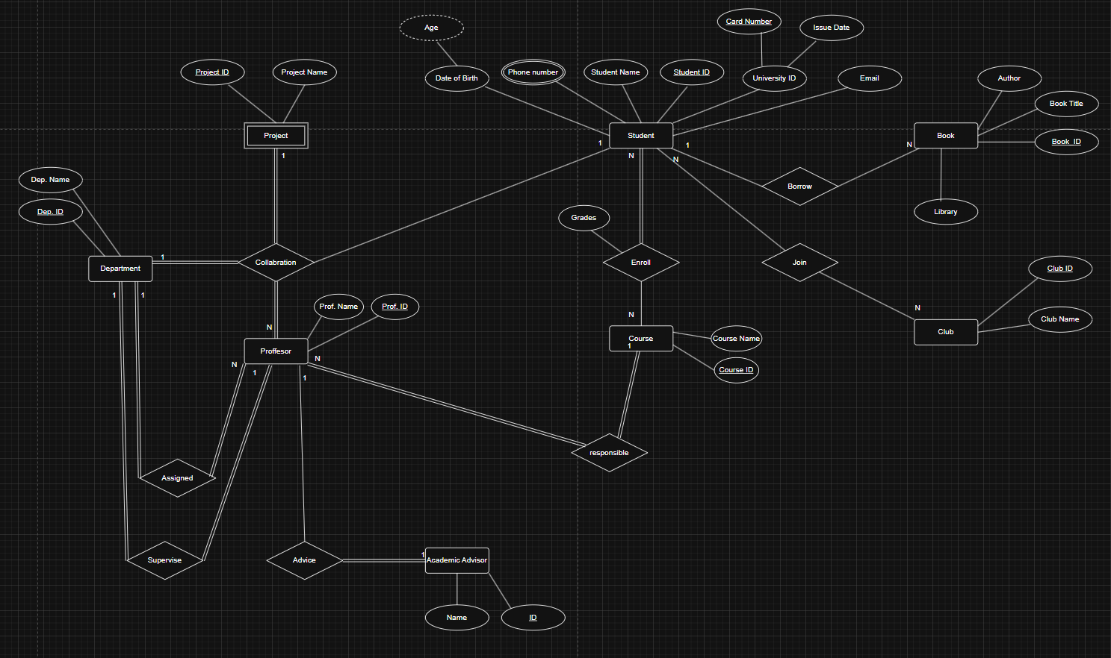
FULL ERD DIAGRAM
Entity-Relationship Diagram (ERD) — Final Model

Slide 12
Thank You

